Slide 1

Access UChicago Now
Town Hall
October 28, 2019

Slide 2
Welcome!
Access UChicago Now
Sponsored by the Office for Access and Equity, Student Disability Services, and Employee and Labor Relations in partnership with the D+I Studio

Slide 3
Agenda
1:00 pm: Framing Presentation
1:20 pm: Poster Review
1:30 pm: Break-Out Discussions
2:10 pm: Reflection
2:30 pm: End

Slide 4
Introduction
Origins & purpose
Centralized initiative seeking multiple perspectives regarding the way in which the University advances its core commitment to access.
Goals
  Increase awareness.
  Evaluate current University work.
  Promote disability as an element of diversity.

Slide 5
Access UChicago Now recognizes that there are multiple ways to succeed in the life of the University; it supports the advancement of the University’s commitment to rigorous inquiry that is inclusive of difference.

Slide 6
Timeline
3/19
Access
UChicago Now
established
4/19
Listening tour begins
students, faculty
6/19
Listening tour continues
staff,
campus
partners
10/19
Town Hall
students,
faculty,
staff,
campus
partners
2020
Recommend-ations

Slide 7
Accessibility at UChicago
1

Slide 8
Students with a Disability at UChicago
Students who are registered with SDS¹
Students who self-identified as having a disability²
Undergraduate
8%
3%
18%
13%
Graduate/ Professional
¹ UChicago data as of Spring 2019 ² 2016 Campus Climate Survey

Slide 9
774
UChicago Students are registered with Student Disability Services

Slide 10
UChicago core commitments to access
Full and equal access
Non-discrimination
Diversity is a “core academic function”
of the University—Diversity Advisory Council Final Report, 2017
Accommodations

Slide 11
Accommodations Offices
Student Disability Services
Students
Office for Access
and Equity
Faculty
Other Academic Appointees
Postdoctoral
Researchers
Visitors
Employee and
Labor Relations
Staff

Slide 12
Accommodations Process
Interactive Process
Determination/ Implementation
Request (or Refer)
Modification or adjustment to provide full and equal access
Equally effective
Not fundamental alteration or undue burden

Slide 13
[A]ll have a stake in helping create and maintain a campus environment that affirms the right to learn, inquire, and grow for everyone.
- Diversity Advisory Council Final Report, 2017
”

Slide 14
Accessibility and Inclusion Efforts Across Campus
Diversity is a “core academic function” of the University, and “all have a stake.” – Diversity Advisory Council, Final Report, 2017
Working for access.
SDS, OAE, & ELR
AWG & ADRC
Chicago Center for Teaching
Student Advisory Board

Slide 15
Access UChicago Now
Listening Tour
2

Slide 16
Listening Tour: Key Questions
What are key challenges related to accessibility, including the accommodation processes, at the University?
How can we work to advance disability inclusion?

Slide 17
Listening Tour Participation
35 Interviews with over 55 students, faculty and staff, including
Center for Identity & Inclusion
Chicago Center for Teaching
Deans of Students/ Disability Liaisons
Employee Labor Relations
Facilities
Housing & Residence Life
Human Resources Partners
IT Services
Library Services
Parking and Transportation
Student Counseling Services
Talent Acquisition/ Shared Services
Court Theater
UChicago GRAD

Slide 18
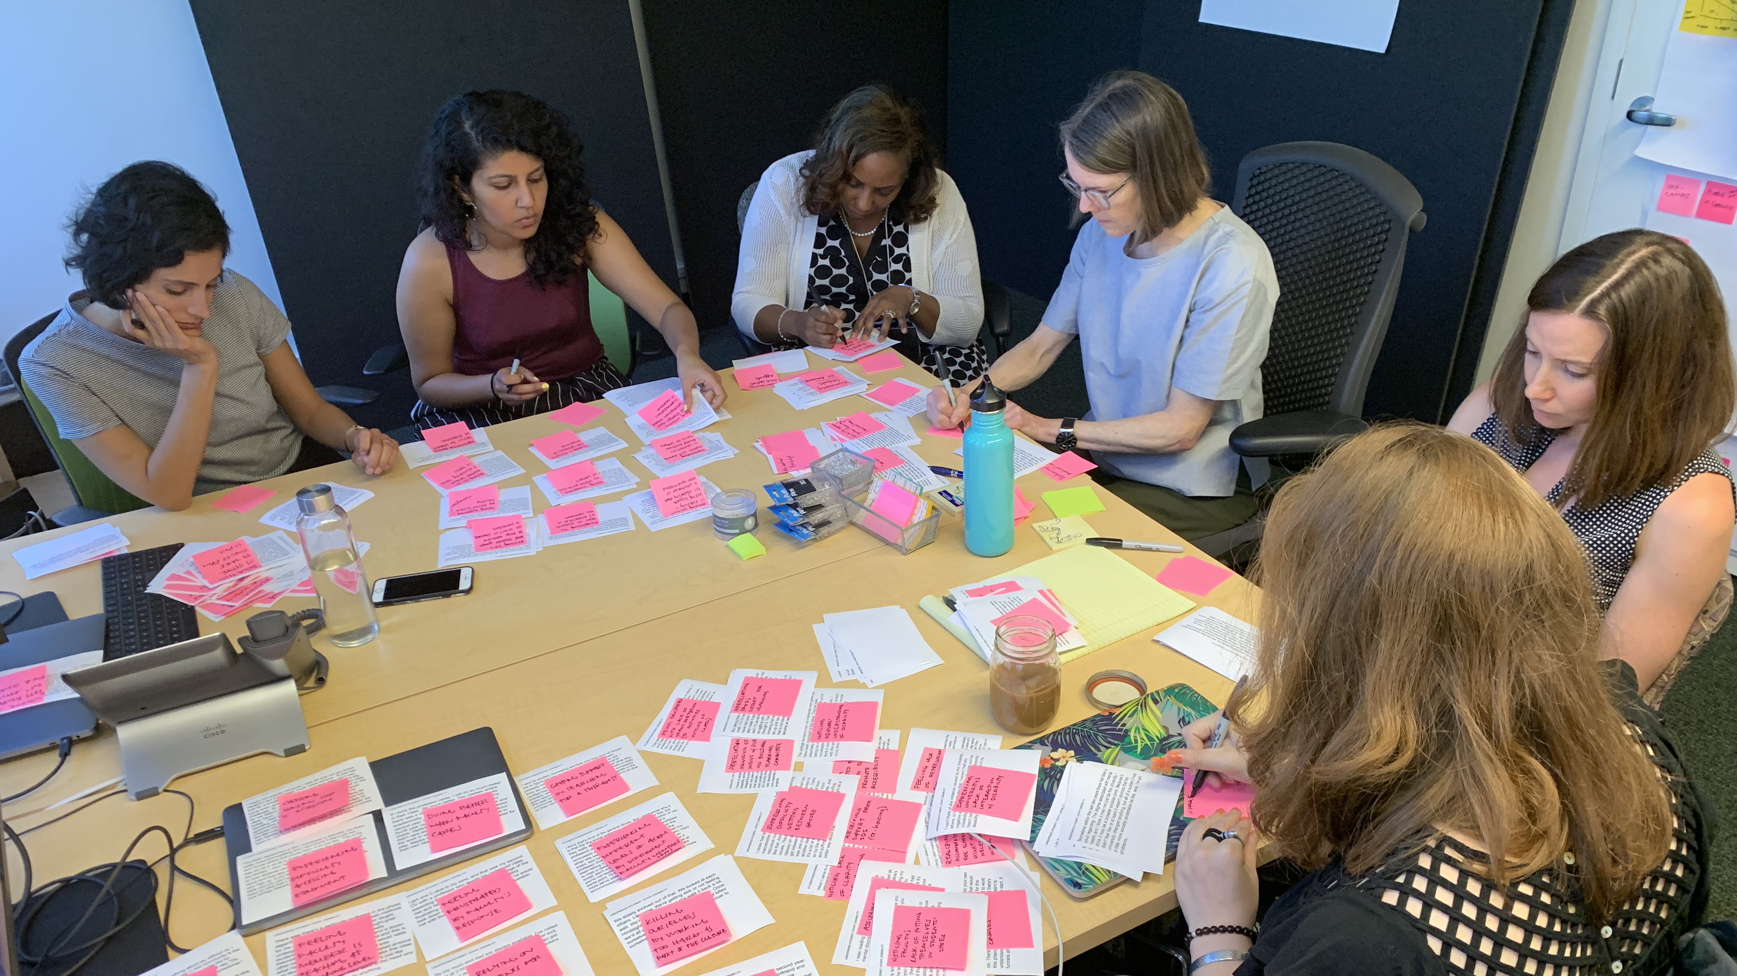
Synthesis
Synthesis

Slide 19
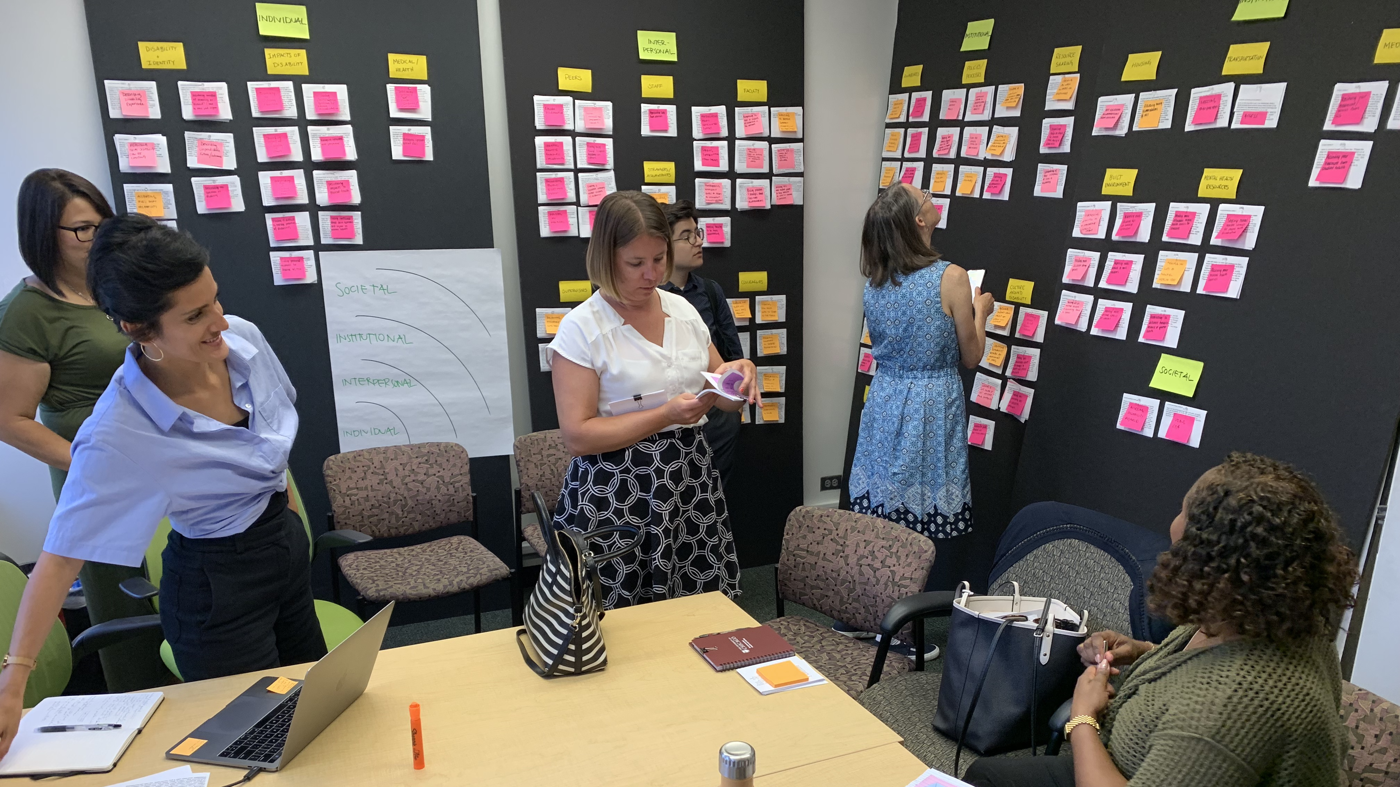
Synthesis

Slide 20
Understanding accessibility at UChicago
Listening Tour Insight Framework

Slide 21
Category Definitions
Our Identities
The ways in which having a disability in an ableist environment shape personal beliefs and experiences
Our Classrooms
The interactions students with disabilities have with their peers and instructors that influence how supported they feel and how they perform academically
Our Processes
The institutional policies and practices that people with disabilities must navigate in order to receive proper accommodations

Slide 22
Category Definitions cont.
Our Community
The local culture and climate that impacts how much individuals with disabilities feel included, valued and empowered
Our Resources
The institutional infrastructure that individuals with disabilities interact with in order to participate in the life of the campus

Slide 23
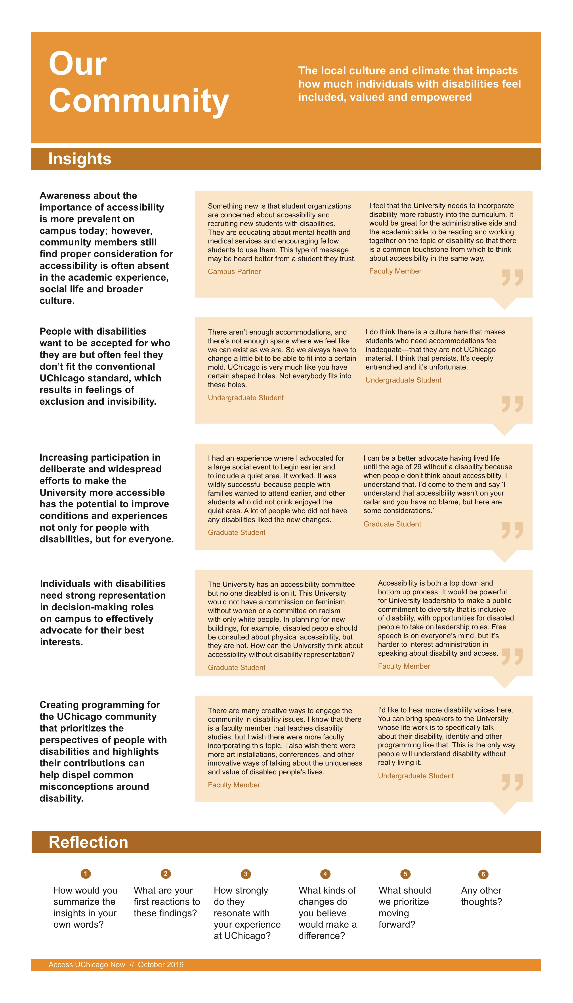
category
definition
Poster
Layout
quotes from students, staff, faculty and campus partners
key insights
questions to discuss

Slide 24
Breakout Session
1
2
3
4
Review Listening Tour insights located around the room on posters / handouts and select one to discuss during the breakout session.
1:20pm – 1:30pm
Share your reflections and feedback on the particular insights with your small group.
1:30pm – 2:10pm
Pick a scribe to record points articulated during the discussion on sticky notes, and attach them to the poster.
Select 1-2 people to share out the poster topic, key insights and ideas for advancement, in 3 minutes.
2:10pm – 2:30pm

Slide 25
Understanding accessibility at UChicago
Listening Tour Insight Framework

Slide 26
Access UChicago Now
What’s Next?
3

Slide 27
Next Steps
Stay Involved. Look for updates and additional ways to participate.
Stay Connected. Sign up for Access UChicago Now email list.
Stay Tuned. Access UChicago Now recommendations to be shared with campus community (anticipated Spring 2020).

Slide 28
Thank you!

